Slide 1
Regional Sales Analysis

Slide 2
Outline
Problem Statement
Approach
Data Overview
Project Workflow
Exploratory Data Analysis
Keu insights
Recommendation
Dashboard Preview

Slide 3
Problem Statement
Sales teams often don’t have a clear picture of how each region is performing. This makes it hard to spot growth opportunities and use resources wisely. The project will study and show regional sales data to reveal trends, check profitability, and help in better decision-making.
What’s the Business Question?
Inconsistent revenue and profit performance across U.S. regions
Lack of visibility into seasonal swings, top SKUs, and channel profitability
Goal: Leverage 5 years of historical data to pinpoint growth levers and optimize strategy

Slide 4

Approach
Exploratory Data Analysis
Interactive Dashboard
Dive into historical sales, margins, products, channels, regions
Build a live view for business Users to self serve insights
Surface trend, outliers & relationships
Enable ad-hoc slicing by time, product, region, channel

Slide 5
Project Workflow
Define Business Objective
Collect & Consolidate Data
De
De
1
1
1
Understand the core problem and expected business outcomes.
2
Gather multi-source sales data (Excel sheets) and understand schema.
De
Pre-processing & Cleaning
Data Loading & Initial Exploration
De
1
1
4
Handle nulls, join tables, format dates, and normalize columns.
3
Load into Colab for initial profiling and data understanding using Python.
De
De
Dashboarding & Recommendations
Exploratory Data Analysis (EDA)
1
1
5
Visualize trends, compare performance, and extract key insights.
6
Build Power BI dashboard and present strategic findings.

Slide 6
Raw Dataset Structure – Before Processing
Sales, products, budgets, customers, regions, and states were spread across unlinked tables. No relationships were defined initially— Pre-processing was required to clean, normalize, and join them for analysis.

Slide 7

Exploratory Data Analysis (EDA)
Finding patterns, trends, and insights from past data.
Understanding the “What, Where & Why” behind the sales numbers
Exploring data through visuals, aggregations, and comparisons
Laying the groundwork for informed recommendations

Slide 8
EDA: Step‑by‑Step Process
Import Libraries
Load Data
Initial Exploration
Pre-processing & Cleaning
Feature Engineering
EDA & Visualization
Key Insights
Recommendations

Slide 9
Pre-processing & Feature Engineering
The necessary steps applied to prepare this dataset for analysis.
Set headers – Make sure the state–region table has proper column names.
Combine tables – Merge Sales, Customers, Products, Regions, State–Region, and Budgets into one dataset.
Remove duplicates – Drop any columns that repeat the same information.
Standardize names – Convert all column names to lowercase for consistency.
Keep only useful data – Select the key columns needed for analysis.
Rename columns – Give columns simple, meaningful names.
Add new metrics – Create columns for profit and profit margin percentage.
✅ Note: no missing values or duplicate rows were found.

Slide 10
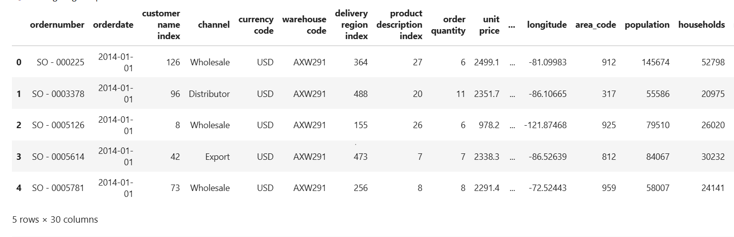
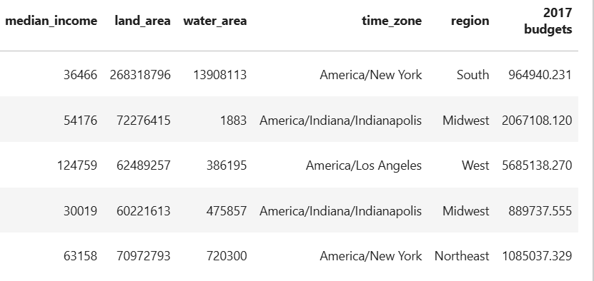
Final Dataset Structure – Ready for Analysis
Identifiers: order_number, order_date, customer_name, channel, product_name Financials: quantity, unit_price, revenue, cost, profit, profit_margin_pct
Calendar: order_month_name, order_month_num, order_month
Geography: state (code), state_name, us_region, lat, lon Planning: budget (2017)

Slide 11
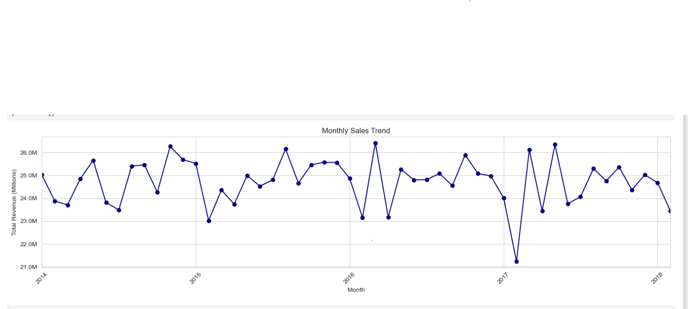
Charts & Insights
Monthly Sales Trend Over Time

Slide 12

Insights
Stable sales range: Revenue usually stays between $24M and $26M.
Seasonal highs: Sales peak in late spring and early summer (May–June).
Annual low point: January is the weakest month for sales.
Unusual event: There was a sharp drop in revenue in early 2017.

Slide 13
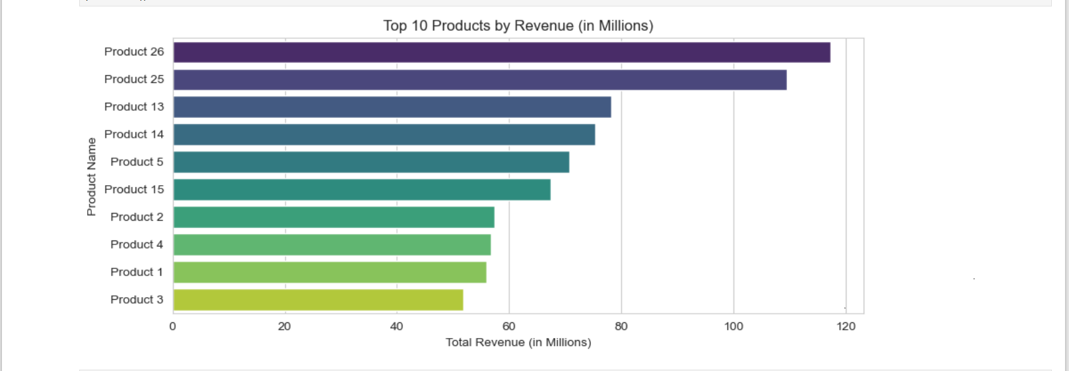
Top 10 Products by Revenue
Insights
Top performers: Products 26 and 25 lead in revenue.
Middle group: Products 5, 13, 14, and 15 earn similar mid-range revenue.
Lower group: Products 1, 2, 3, and 4 generate the least revenue.
Plan: Focus on growing the mid-tier and improving weaker products.

Slide 14
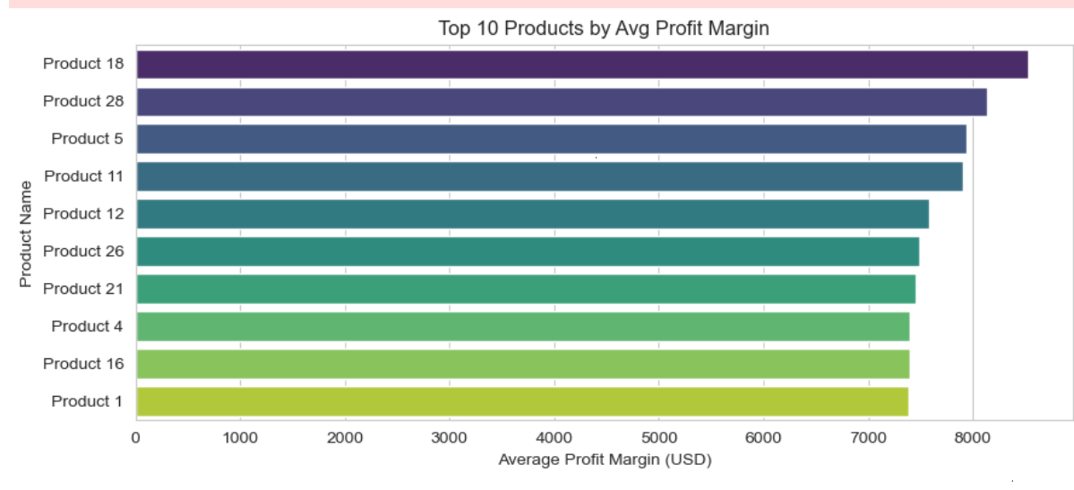
Top 10 Products by Average Profit Margin
Insights
Top: Products 18 & 28 lead at ~$8.1–8.4K.
Next tier: Products 5, 11, 12 & 26 at ~$7.5–7.8K.
Entry‑level: Products 1, 4, 16 & 21 around $7.3K.
Takeaway: Top 10 all exceed $7.3K—consistent high margins.

Slide 15
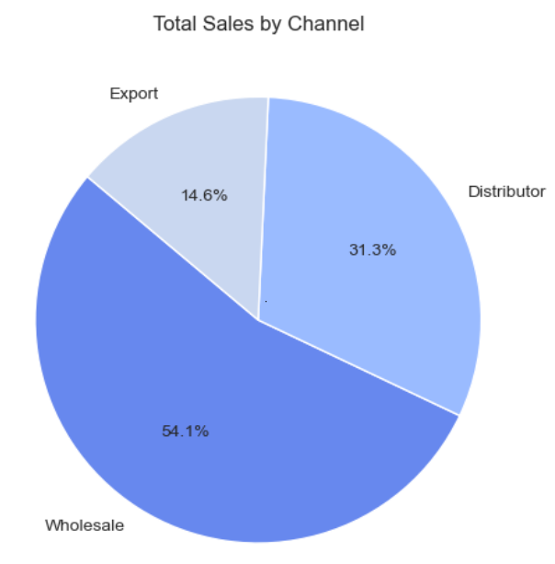
Sales by Channel
Insights
Wholesale leads: It makes up the largest share of sales at 54.1%.
Distributor is strong: Contributes a solid 31.3% of sales.
Export is smaller: Accounts for 14.6% of total sales.

Slide 16
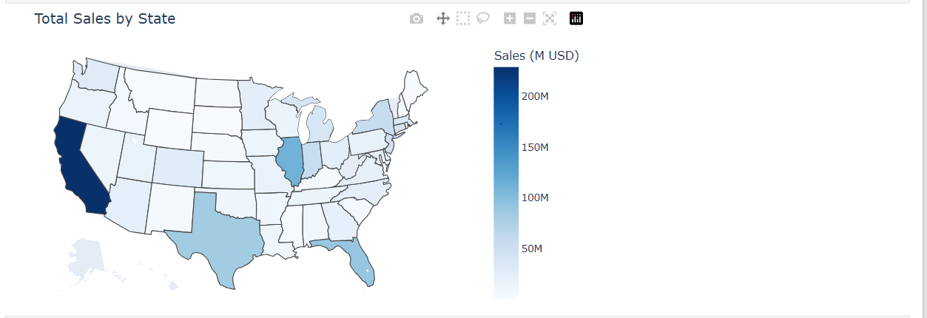
Total Sales by State (Choropleth Map)
Insights
California is the leader: It has the highest total sales.
Strong performers: Texas, Florida, and Illinois also show significant sales.
Mixed results: Other states range from moderate to low sales.
Pattern: Bigger states and some coastal states tend to have higher sales.

Slide 17
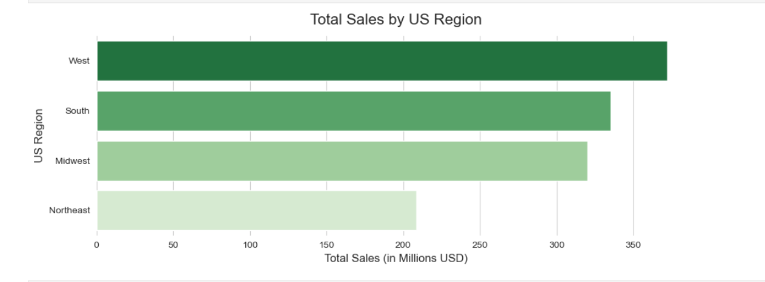
Total Sales by US Region
West: Highest sales, strong market influence.
South: Major sales contributor, key market area.
Midwest: Steady sales performance, moderate market size.
Northeast: Lowest sales, suggests need for deeper market understanding.
Insights

Slide 18
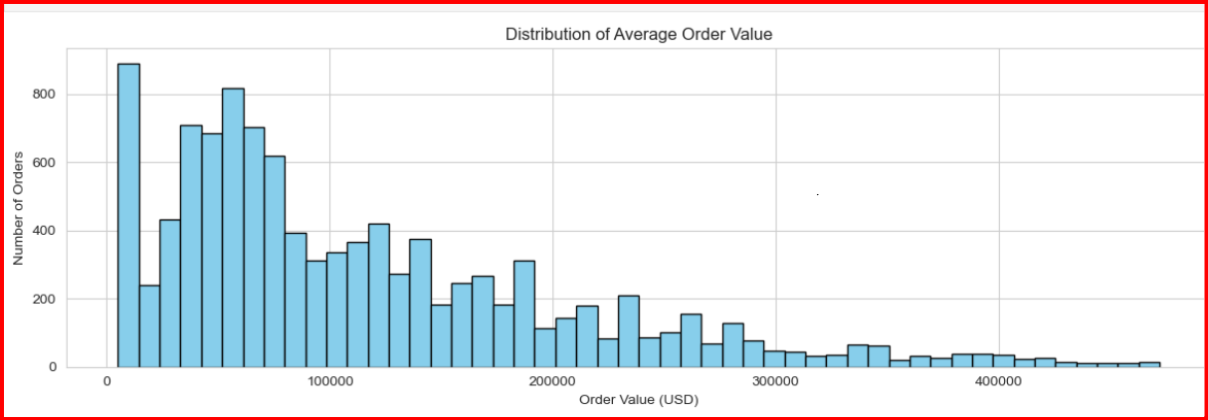
Average Order Value (AOV) Distribution
Insights
Low average order values are frequent.
Distribution is right-skewed (long tail of high-value orders).
Multiple order value clusters exist.
Higher order values are less common.

Slide 19
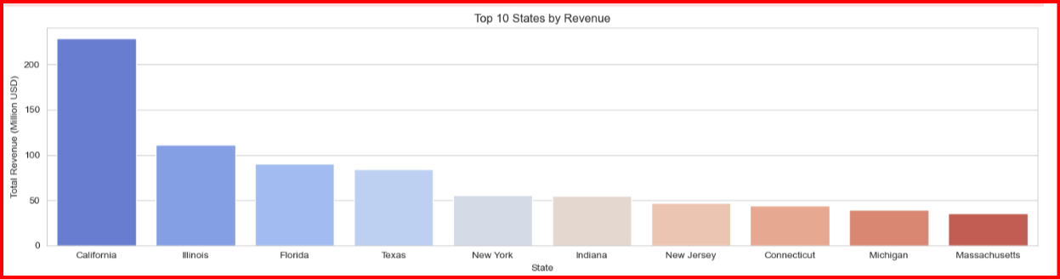
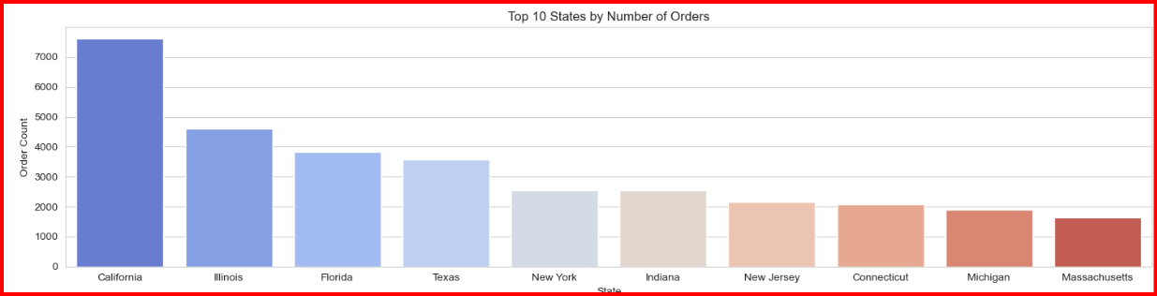
Top State Performance: Revenue vs. Orders
Insights
California tops revenue & orders.
IL, FL, TX: High in both.
Revenue & orders linked.
Other top states: Lower contribution.

Slide 20
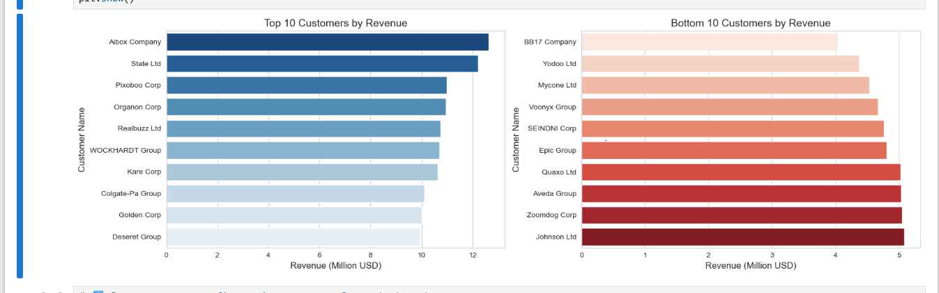
Top and Bottom 10 Customers by Revenue
Insights
Aibox Company leads significantly as the top revenue generator.
Bottom 10 customers generate substantially less revenue (around $4-5M).
Revenue concentration: Top customers drive a disproportionate share.
Large gap: Exists between the revenue of top and bottom tier customers.

Slide 21
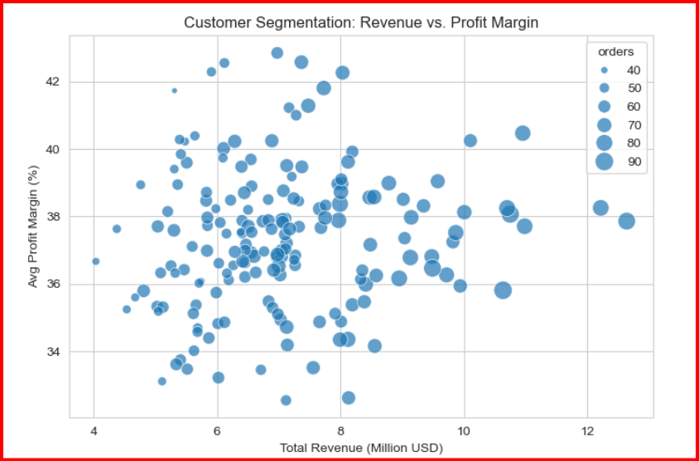
Customer Segmentation: Revenue vs. Profit Margin
Insights
Strong margins: Most accounts show steady margins of 35–40%, proving good pricing and cost control.
Discounting issue: Large clients (>$10M) with margins below 36% may be getting too many discounts — their terms should be reviewed.
Upsell potential: Mid-size clients ($6–9M) with margins above 40% are valuable targets for upselling.

Slide 22
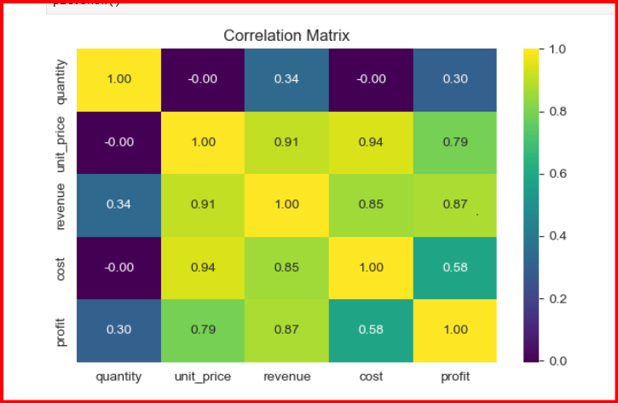
Correlation Heatmap of Numeric Features
Insights
Unit price matters most: It strongly connects with cost (0.94), revenue (0.91), and profit (0.79).
Revenue and profit go hand-in-hand: Their high link (0.87) shows that more revenue directly boosts profitability.
Quantity has little effect: With correlations ≤0.34, sales volume plays only a minor role compared to pricing.
Cost vs. profit is moderate: At 0.58, this suggests that improving margins should focus mainly on pricing strategy.

Slide 23

Key Insights
Seasonality: Sales show clear seasonal patterns — January averages $124M, while April dips to $95M.
SKU Concentration: Just two products (26 & 25) together contribute about 25% of total sales.
Channel Trade‑off:
Wholesale dominates with 54% of sales volume.
Export stands out for profitability, with an average margin of 38%.
Geographic Dominance:
California alone records 7.6K orders worth $230M.
The West region shows the biggest ups and downs in sales.
Key Customers: Aibox Company and State Ltd are the most valuable clients in terms of revenue.

Slide 24

Recommendations
Seasonal Promotions:
Run recovery campaigns in April to lift sales.
Boost offers in January to balance seasonal revenue swings.
SKU Optimization:
Focus more on Products 26 & 25 (top sellers).
Re‑check pricing or consider phasing out low‑margin products.
Channel Expansion:
Encourage Export partnerships to benefit from high margins.
Offer volume deals in Wholesale to strengthen sales.
Regional Investment:
Replicate California’s success in other regions.
Increase marketing in the Northeast and Midwest to grow sales.
Margin Monitoring:
Flag orders with margins below 80%.
Analyze cost drivers to improve weaker segments.

Slide 25
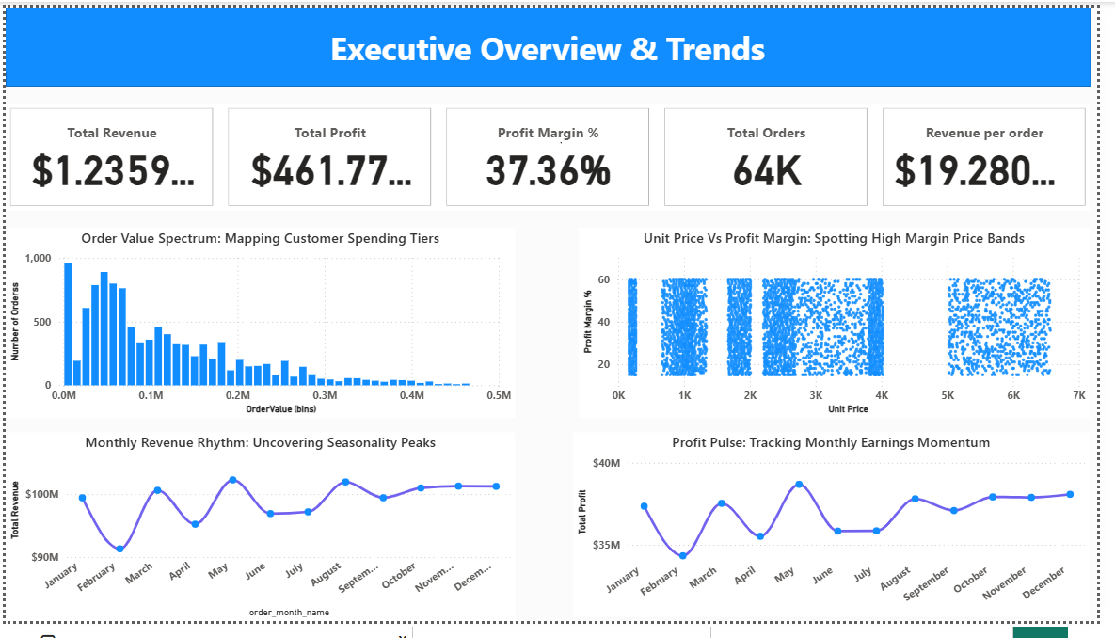
Dashboard Preview
Performance Summary

Slide 26
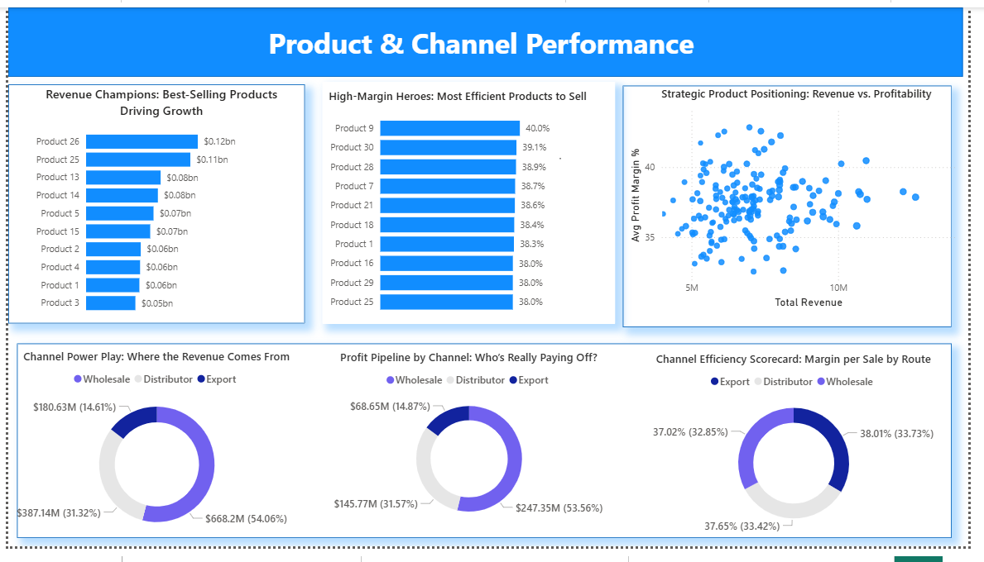
Customer Segmentation

Slide 27
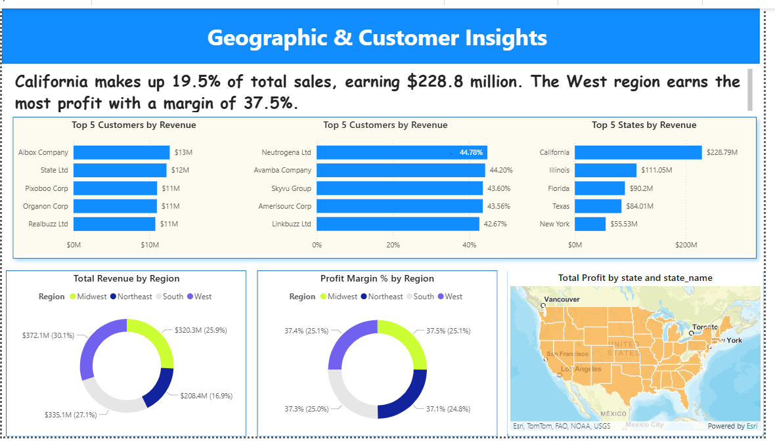
Revenue Scenarios

Slide 28

Conclusions
Data Quality Assurance: The dataset was validated — no missing values or duplicate rows were found, ensuring reliable analysis.
Profitability Metrics: New calculated fields (profit and profit margin %) provide deeper visibility into financial performance.
Correlation Analysis: Strong links between unit price, revenue, and profit highlight pricing as the key driver of margins.
Customer Segmentation: Identification of high‑value clients (>$10M with low margins, $6–9M with high margins) supports targeted discount reviews and upsell strategies.
Operational Efficiency: Insights guide smarter resource allocation across channels, regions, and product lines.
Scalability: The framework allows seamless onboarding of new datasets, making the dashboard adaptable for future business needs.
Strategic Impact: Findings directly inform sales policies, promotional timing, SKU optimization, and regional marketing investments.

